Slide 1

Random walks - diffusion model
Natalia Wołowiec
Kacper Kalinowski
Mateusz Miller

Slide 2

Table of contents
Random walks
Diffusion
Graphs
Python
Bibliography
2
1
2
3
4
5

Slide 3
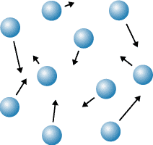
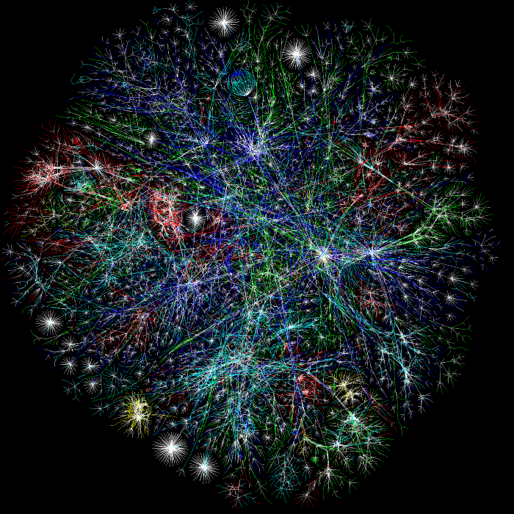
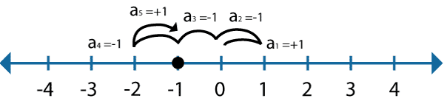
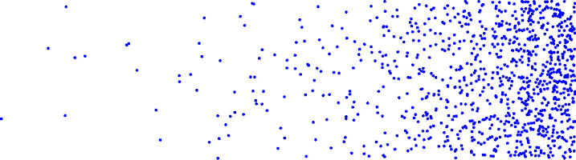
Random walk
What is it?
In real life?
Math behind it
Variable step size?
Biased?
1D – 2D – 3D
3
1
2
3
4
5
6

Slide 4
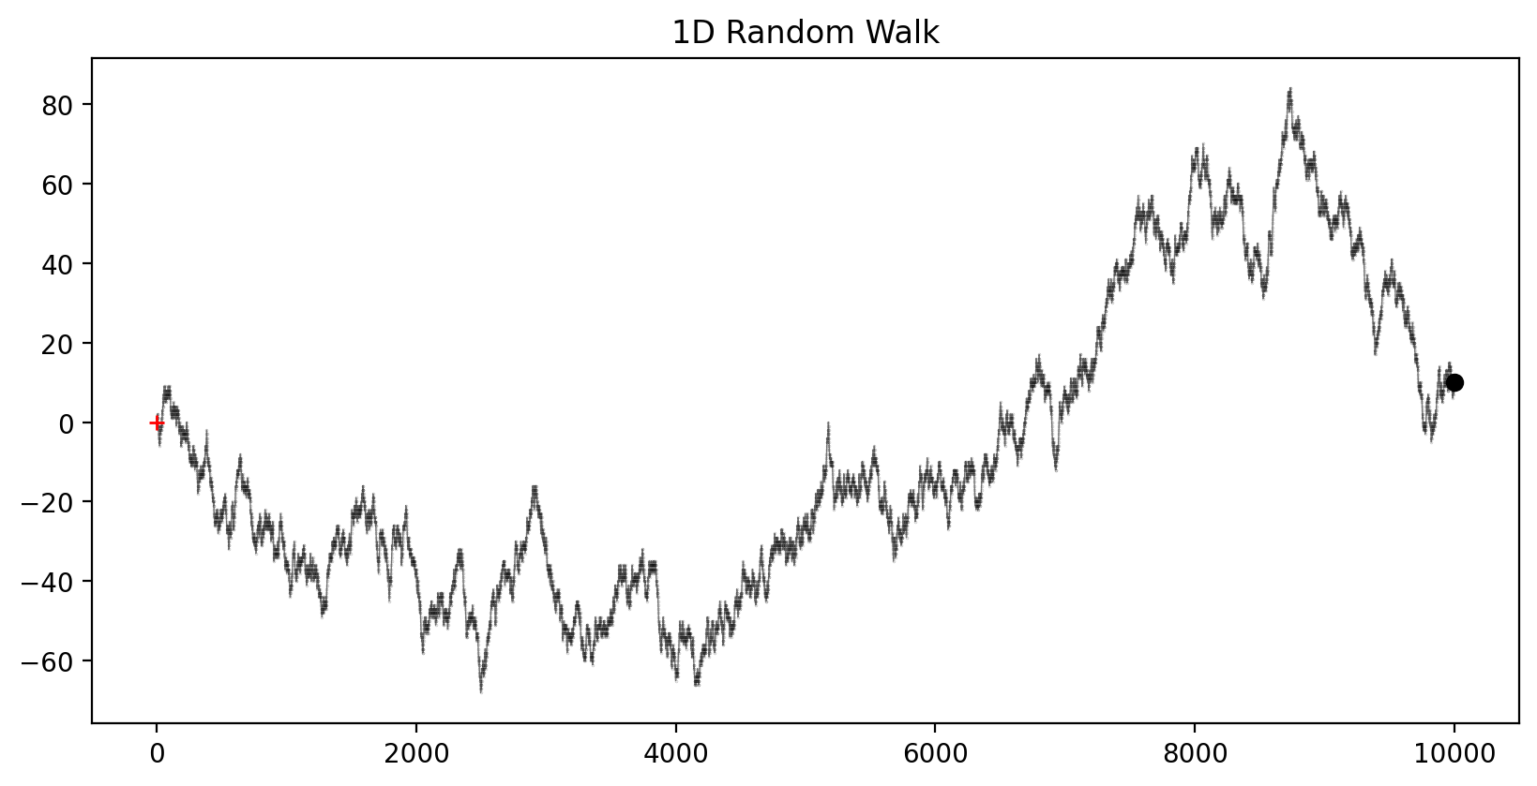
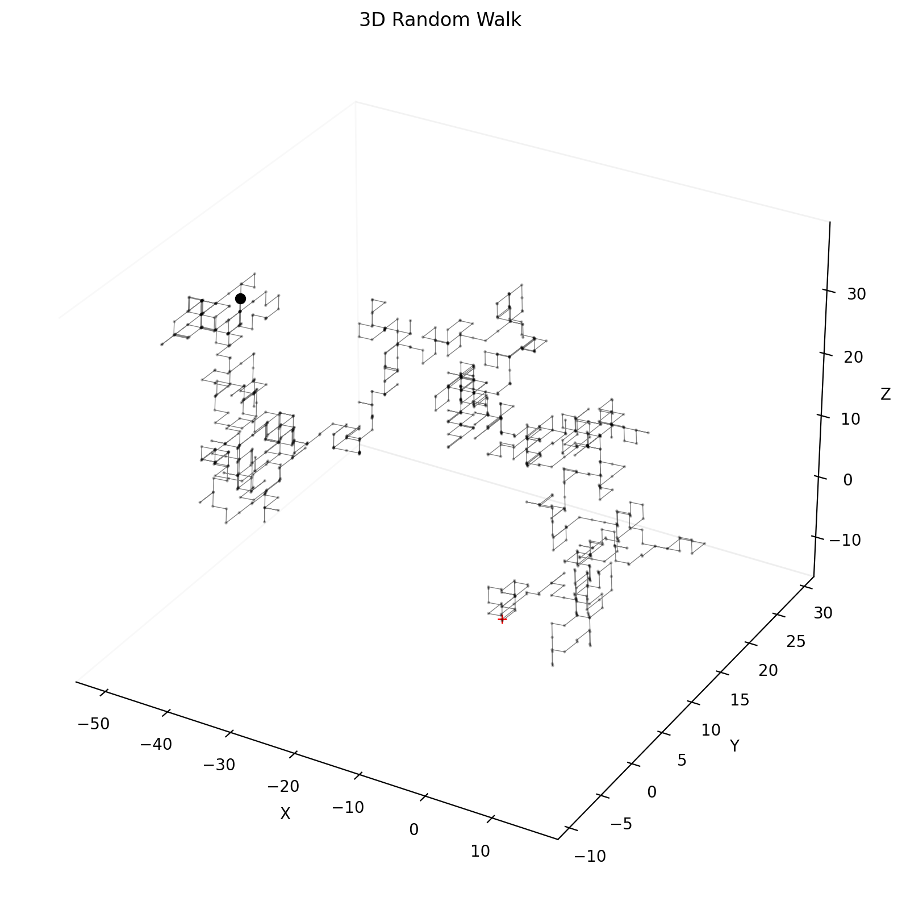

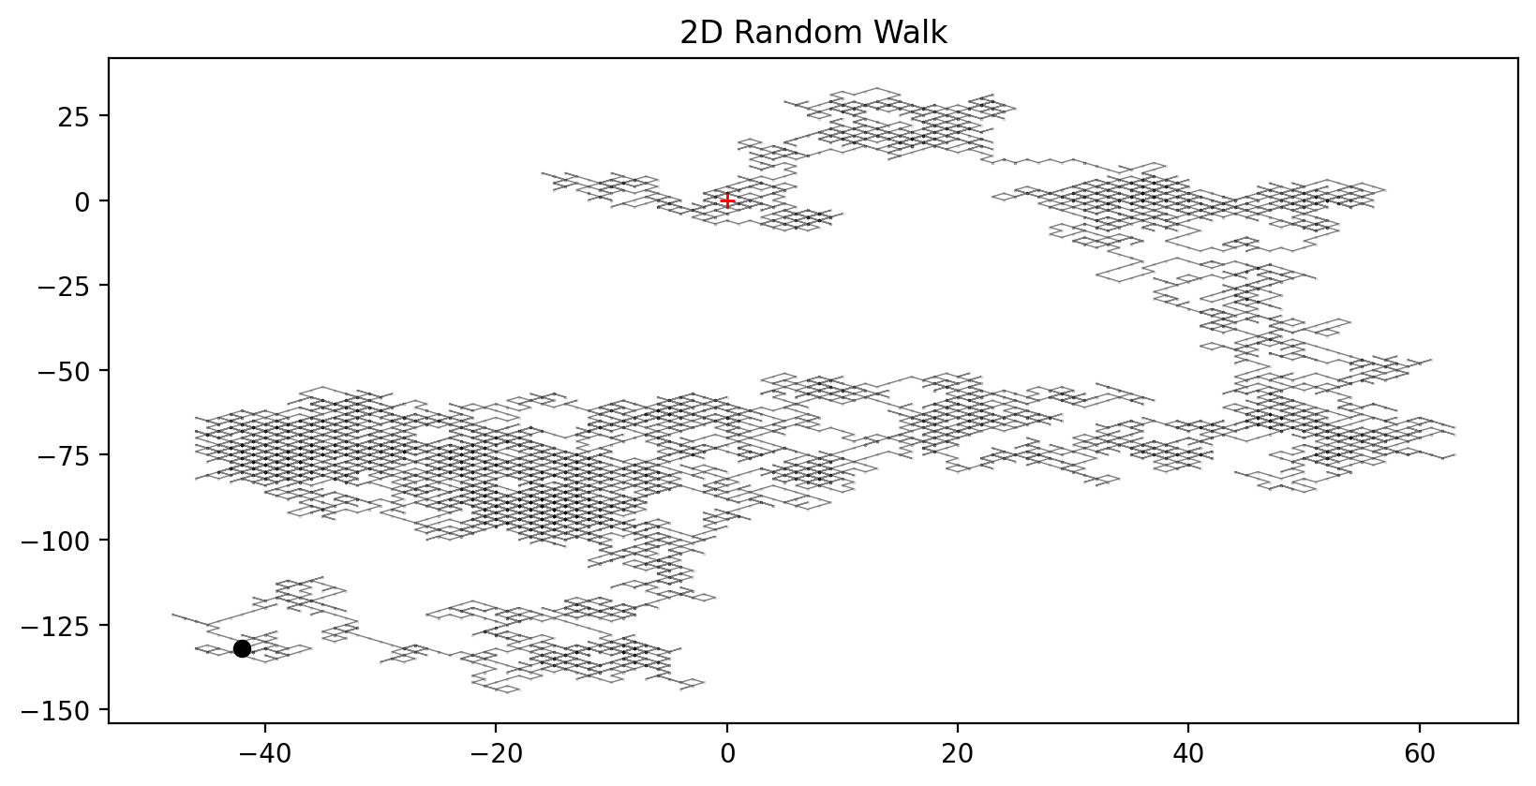
Graphs and pictures
Biased walk toward right
(with step size)

Slide 5
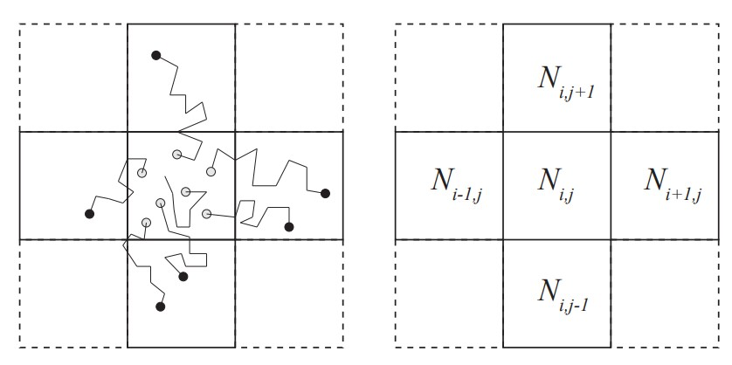
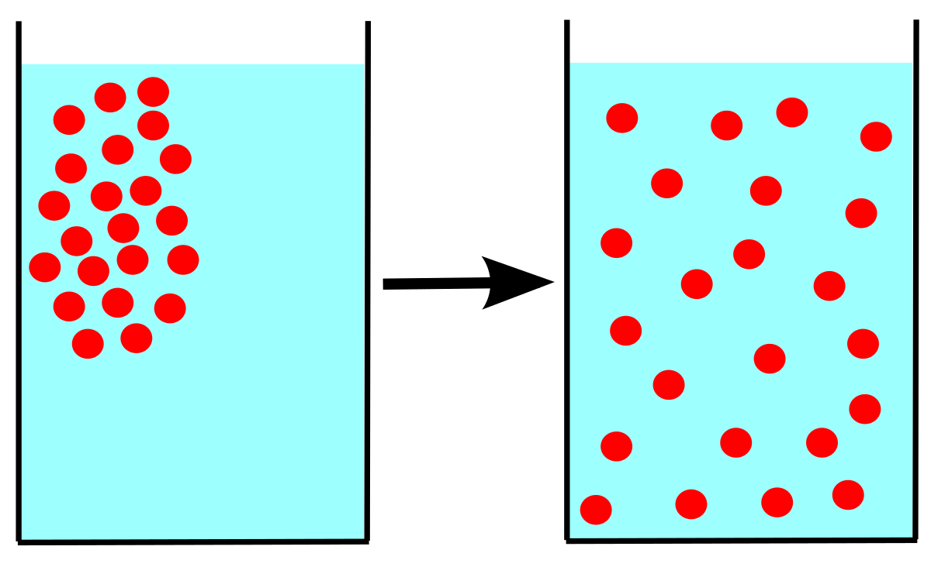
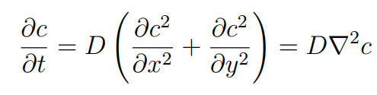
Diffusion
Analysis in one dimension
Two aprroaches
Comparing
Equation
Efficient?
1
2
3
4
5

Slide 6
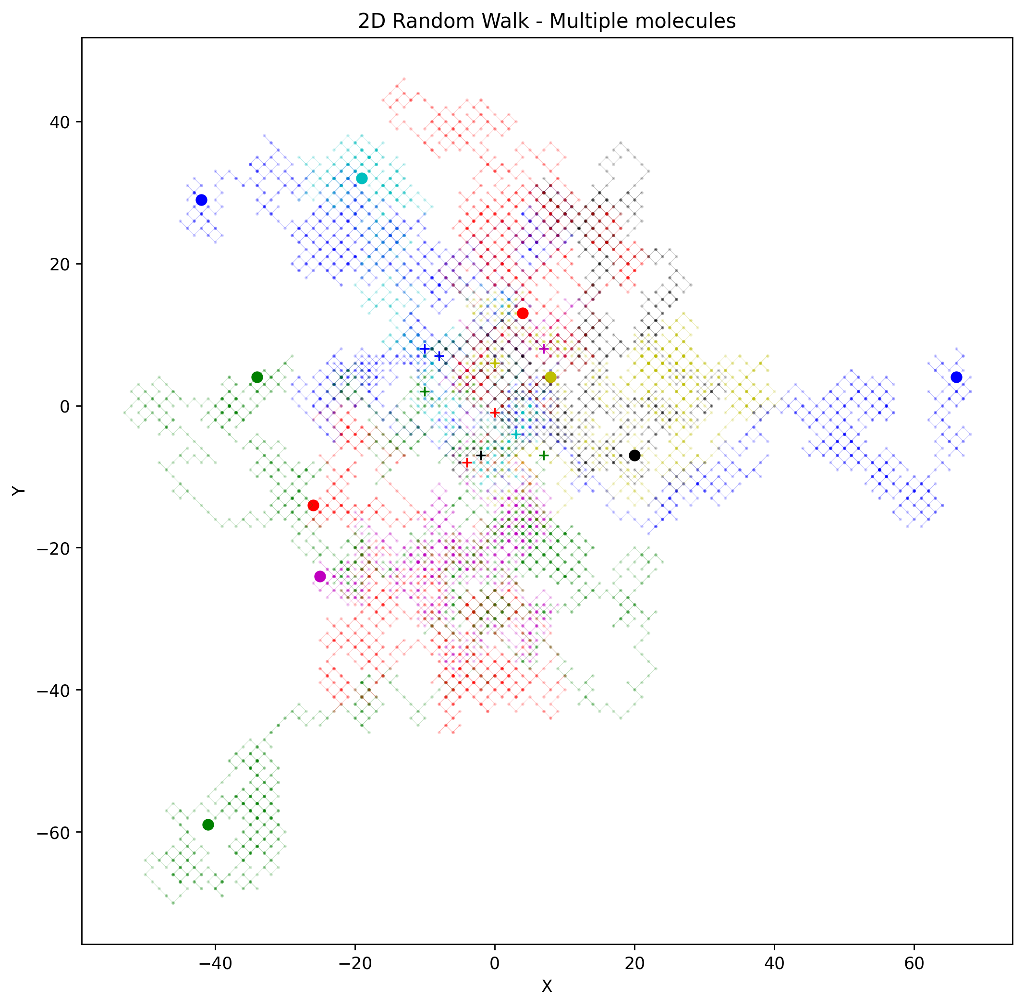
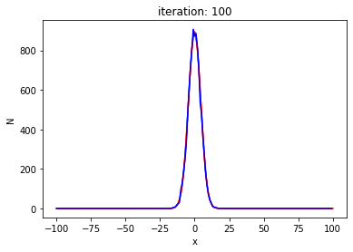
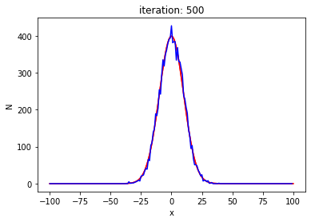
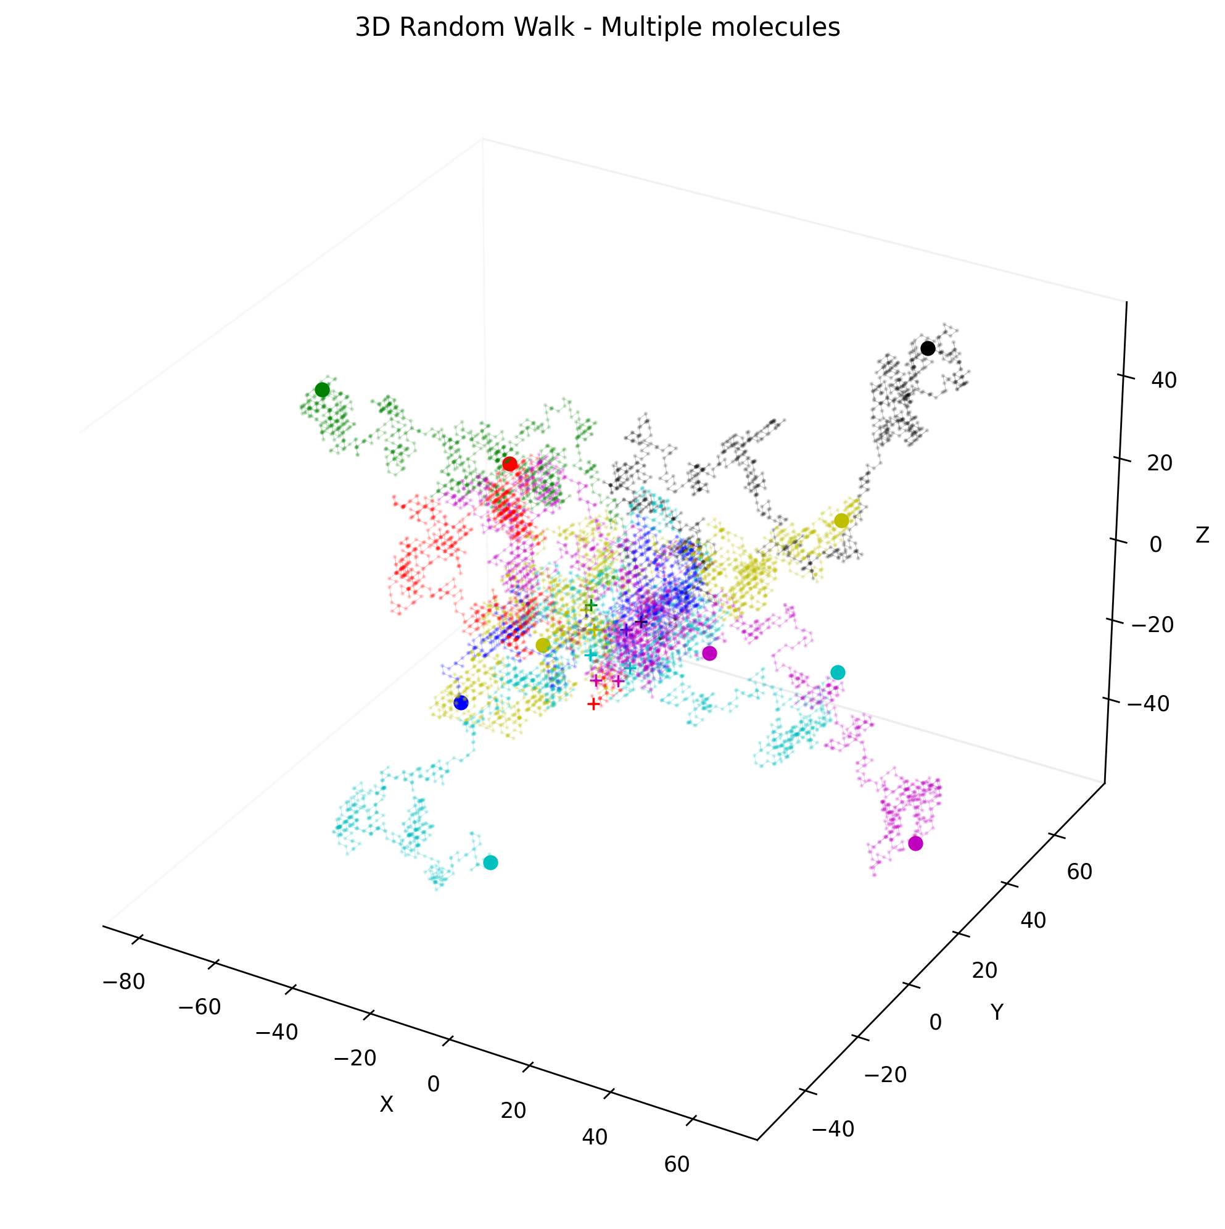
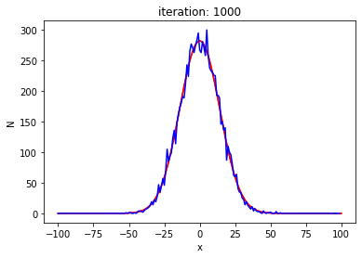
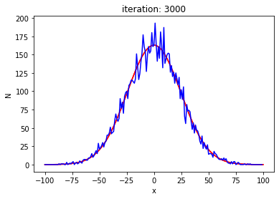
Graphs and pictures v2

Slide 7
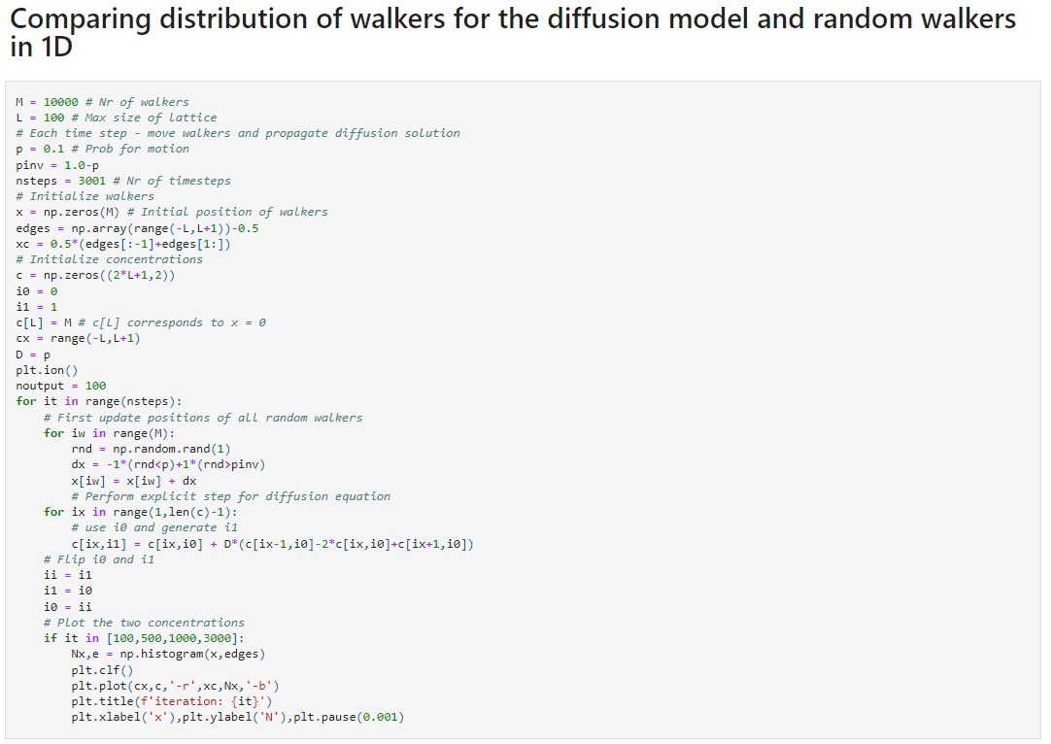
Python

Slide 8

Our code
8
https://github.com/Sheaza/random-walk-pfe-project/blob/main/random-walk.ipynb?fbclid=IwAR3KwjN0D65NQ01cxubP-cgSuRzFS46V9Pf71b8ypnSSkNfjMEgVYHFqD0U

Slide 9
Bibliography
https://www.princeton.edu/~akosmrlj/MAE545_S2018/lecture17_slides.pdf?fbclid=IwAR26zLYwCp1iAUv-qBStrOt_PPKu-IB3jMFyInjCwrmT0tluuq0mIEu-dW0
https://www.mit.edu/~kardar/teaching/projects/chemotaxis(AndreaSchmidt)/random.htm?fbclid=IwAR14J_OFXDJkNBvkr_u9fIvJlqOnIxwy8fUKTbuDPXMoy5mx11ertIAeno0
https://towardsdatascience.com/random-walks-with-python-8420981bc4bc
https://www.uio.no/studier/emner/matnat/fys/FYS2160/h17/simuleringsopgaver/virrevandrer_diffusjon.pdf?fbclid=IwAR19RO0il_U2m9p-g-ZDUe_fzBEa9NotBIVPVtu3_WIWpw-E3CZU3uWbODA

Slide 10
thank you for your attention!
Natalia Wołowiec
Kacper Kalinowski
Mateusz Miller

